Slide 1

Basic Tax Seminar
2012
Baptist General Convention of Oklahoma
Church & Employee Benefit Services
Barbara Spess
Norma Woodard
Thomas Jordan

Slide 2
Section I
Workbook Page 1
Employees and Reporting Requirements

Slide 3
Who is an Employee?
Workbook Page 1
Performs services
Controlled by employer
  What services?
  How performed?

Slide 4
Are You An Employer?, 1-10
Workbook Page 1
Instructions
Training
Integration
Services rendered personally
Hiring, supervising, paying assistants
Continuing relationship
Set hours of work
Full time required
Doing work on employer’s premises
Order or sequence of work

Slide 5
Are You An Employer?, 11-20
Workbook Page 2
Oral or written reports
Payment by hour, week, month
Payment of business expenses
Furnishing of tools and materials
Significant investment
Realization of profit or loss
Working for more than one firm at a time
Making services available to the public
Right to discharge
Right to terminate

Slide 6
Employer-Employee Relationship

Slide 7
Failure to Withhold
Workbook Page 3
Eighth St. Baptist Church vs. the IRS
Penalties
  5% - 25%
  AND
  100%

Slide 8
Failure to Deposit
Workbook Page 4
Penalties
  2%
  5%
  10%
  15%

Slide 9
Who is a Minister?
How to know one when you see one
Workbook Page 6
Minimum: Ordained, commissioned,
or licensed.
In Addition:
Administers “sacraments”
Conducts religious worship
Management responsibility
Considered to be a religious leader by one’s church or denomination.

Slide 10
Licensed Ministers?
Workbook Page 6
Licensed
Ordained
Secular
Housing Allowance
Pays self-employment tax; church cannot withhold and match.
No Housing Allowance
The church Must withhold Social Security and match; No self-employment tax.

Slide 11
Reporting Minister’s Income
Workbook Page 7
W-2 Required for salary
Schedule C for revivals, weddings, etc.
Schedule SE should show income from:
  W-2
  Schedule C
  Housing Allowance

Slide 12
Withholding Taxes for Ministers
Workbook Page 7
A minister’s income is exempt from mandatory withholding. However,
  A church may withhold taxes if requested by the minister.
  Voluntary withholding may include the self-employment tax.
Social Security Offset
  Can be provided by the church to offset the self-employment tax.
  Included in the minister’s taxable income.

Slide 13
Computation of Self-Employment Base
Workbook Page 8
Salary from W-2 $+_____
Schedule C Income $+_____
Value of Parsonage and/or
Church Paid Utilities $+_____
Housing Allowance $+_____
Moving Expense included in W-2 $ -_____
Unreimbursed Moving Expense $ -_____
Unreimbursed Employee Business
Expense included in W-2 $ -_____
Total $ _____

Slide 14
Church Parsonage
Fair Market Rental Value
Workbook Page 9
Employee Status | On or Touching Church Grounds | Federal & State Tax | Social Security & Medicare
Non-Ordained | Yes | No | No
 | No | Yes | Yes

Slide 15
Love Gifts & Bonuses
Workbook Pages 9-10
If given by an individual it is not taxable
If given by the church it is taxable income
Exceptions:
  Tax free de minimis fringe benefits
  Non-taxable length of service awards

Slide 16
Staff Honorariums After Departure
Workbook Page 11
Non-taxable payment
  No consideration for past services
  No relation to salary or length of service
  Not conditioned on further services
  Not conditioned on agreement to retire
  Paid after departure
  Only for love and affection

Slide 17

Low or No Interest Loans
Workbook Pages 12-13
Problems with Loans
  Loans to officers & directors
  Possible “inurement” of assets
  Avoiding taxes for $10,000+
Debt Forgiveness
  Taxable Income
  Report on Form W-2 or W-2c
  Interest that would have been paid to a financial institution is also taxable for loans of $10,000+

Slide 18
Money Gained from Embezzlement
Workbook Pages 13-14
Embezzlement
  Reporting requirements
  Repayment of funds
  Taxable income

Slide 20
Group-Term Life Insurance
Life Insurance Provided by Employer
Imputed Income
Reported on W-2
Use IRS Publication 15-B to calculate

Slide 21
Additional Areas of Caution
Workbook Page 16
Discretionary Funds
  Written church guidelines
  IRS definitions of charitable/needy distributions
Church Credit Cards
  The church must verify every charge
  Unverified charges must be reported as salary

Slide 22
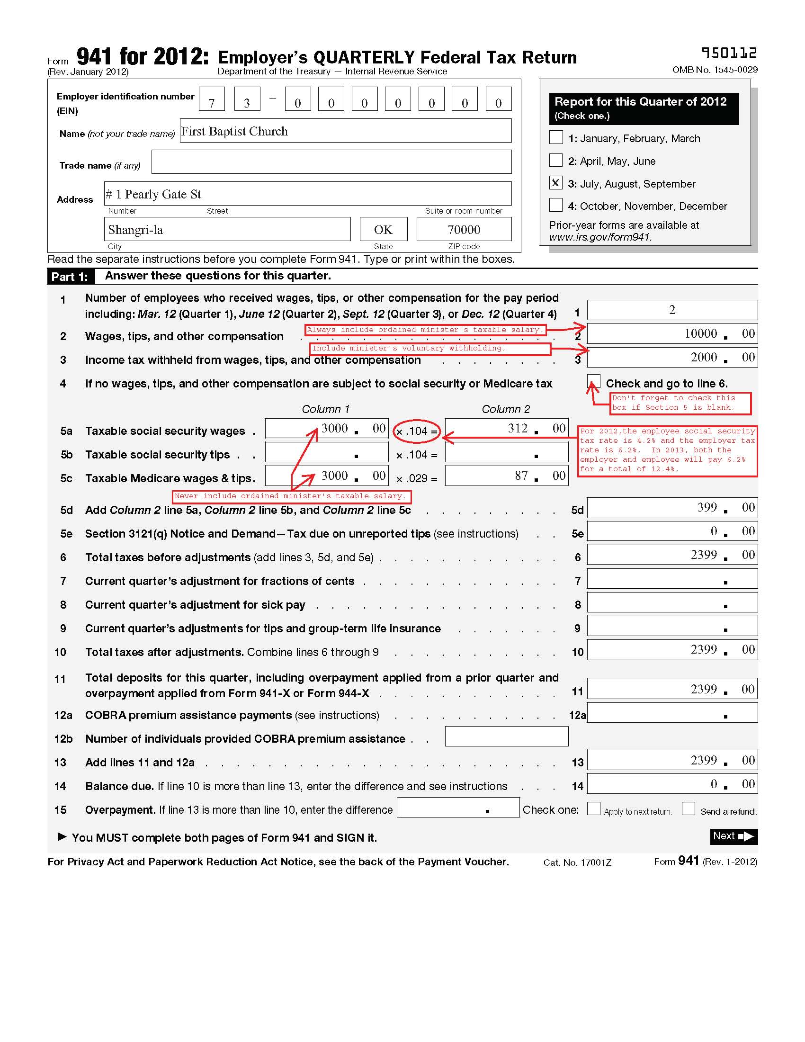
Form 941
Wkbk
Pg 17

Slide 23
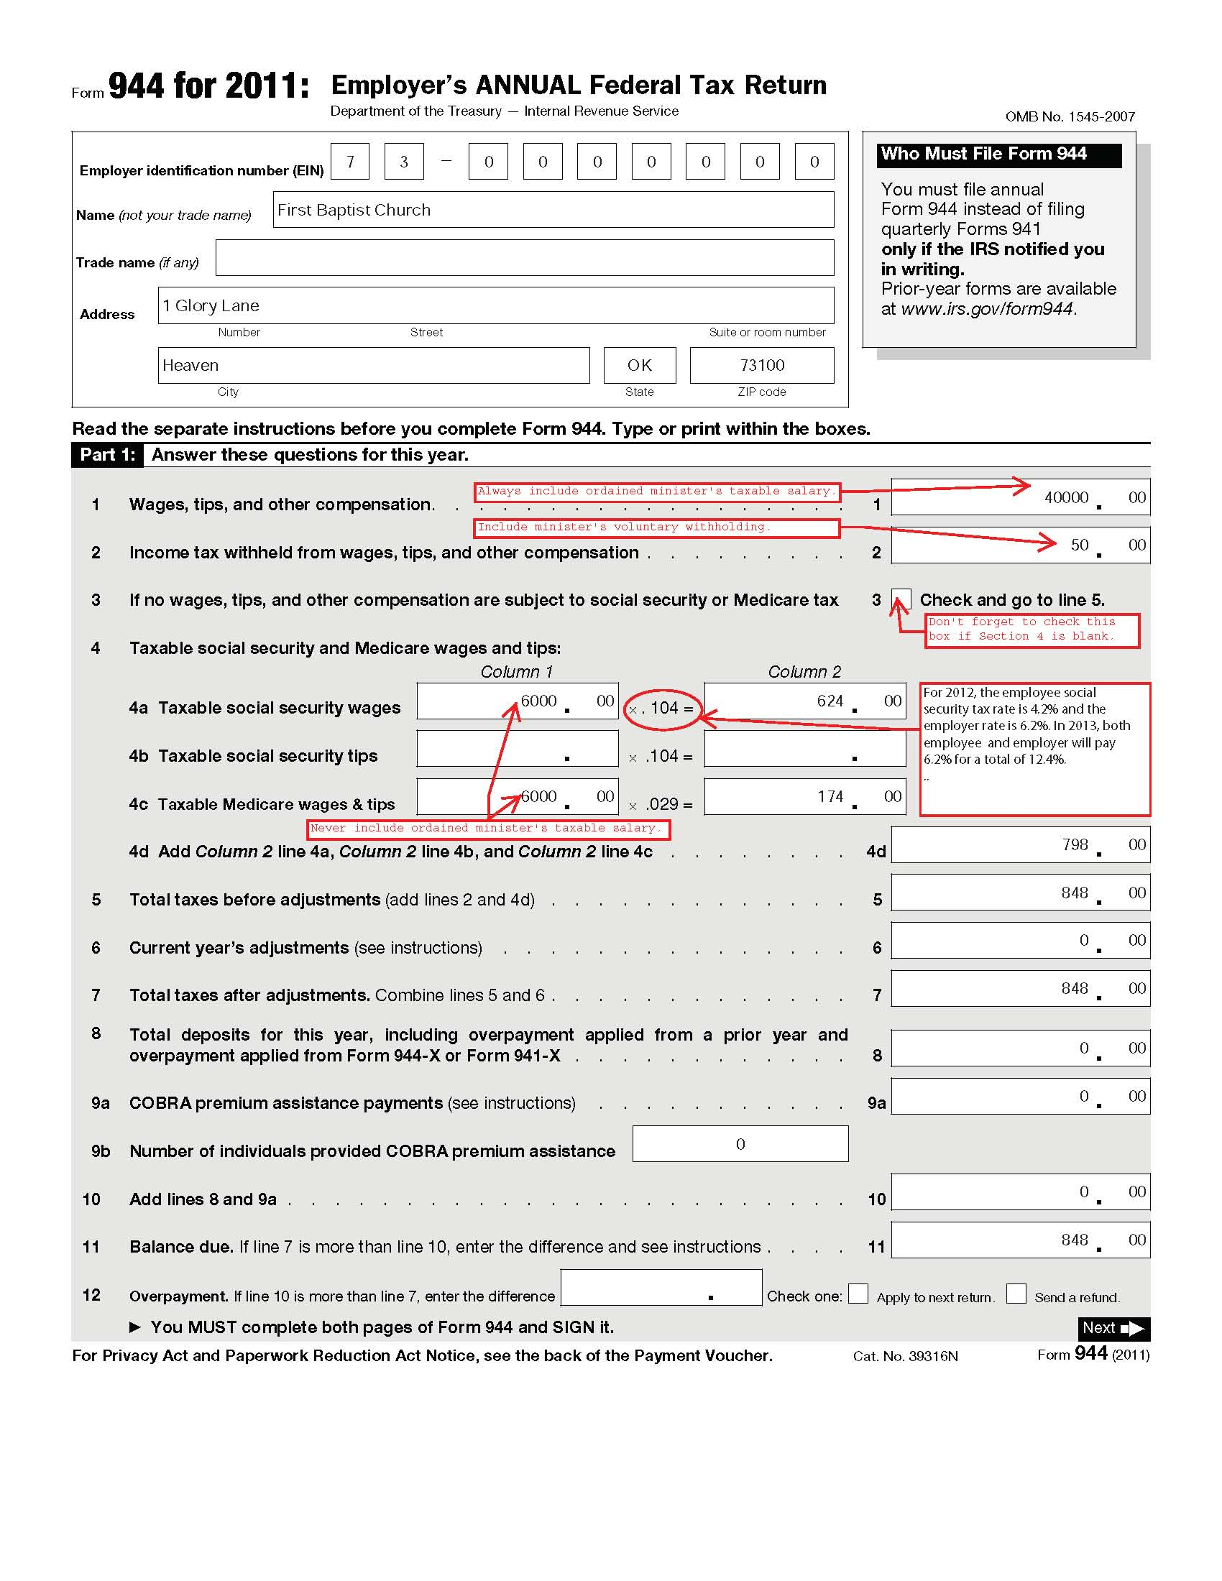
Form 944
Workbook
Pg 24

Slide 24
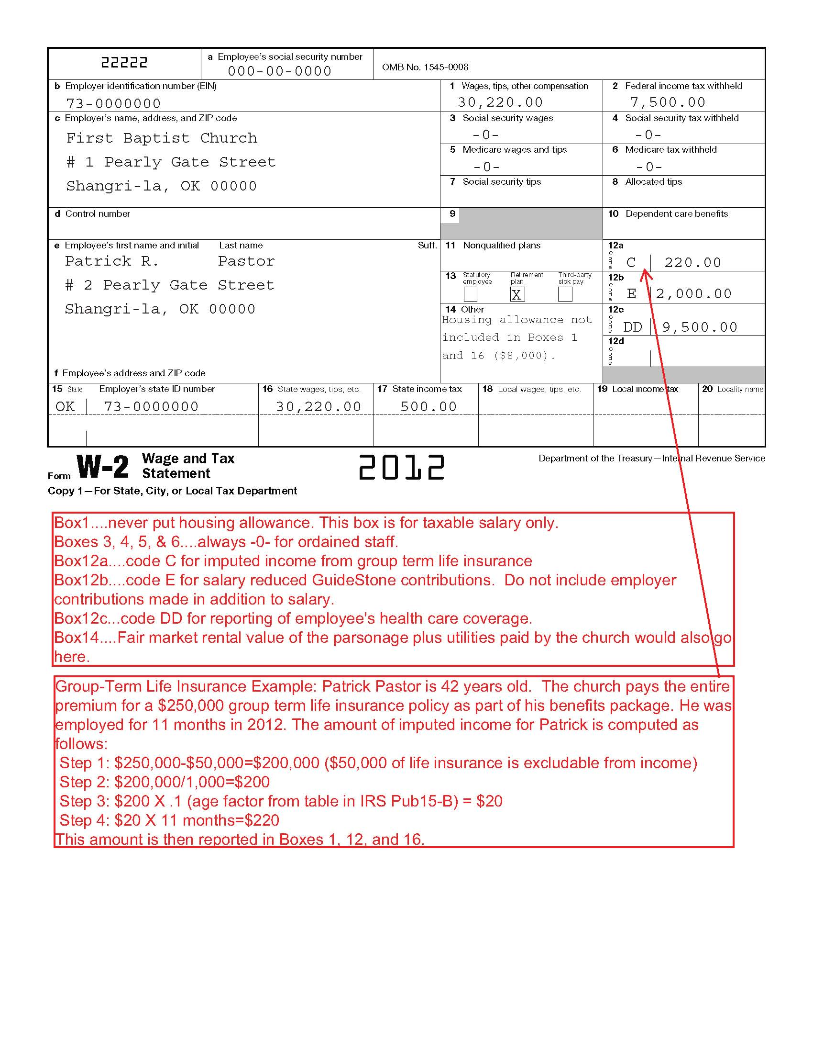
W2, Ordained Staff
Wkbk
Pg 26

Slide 25
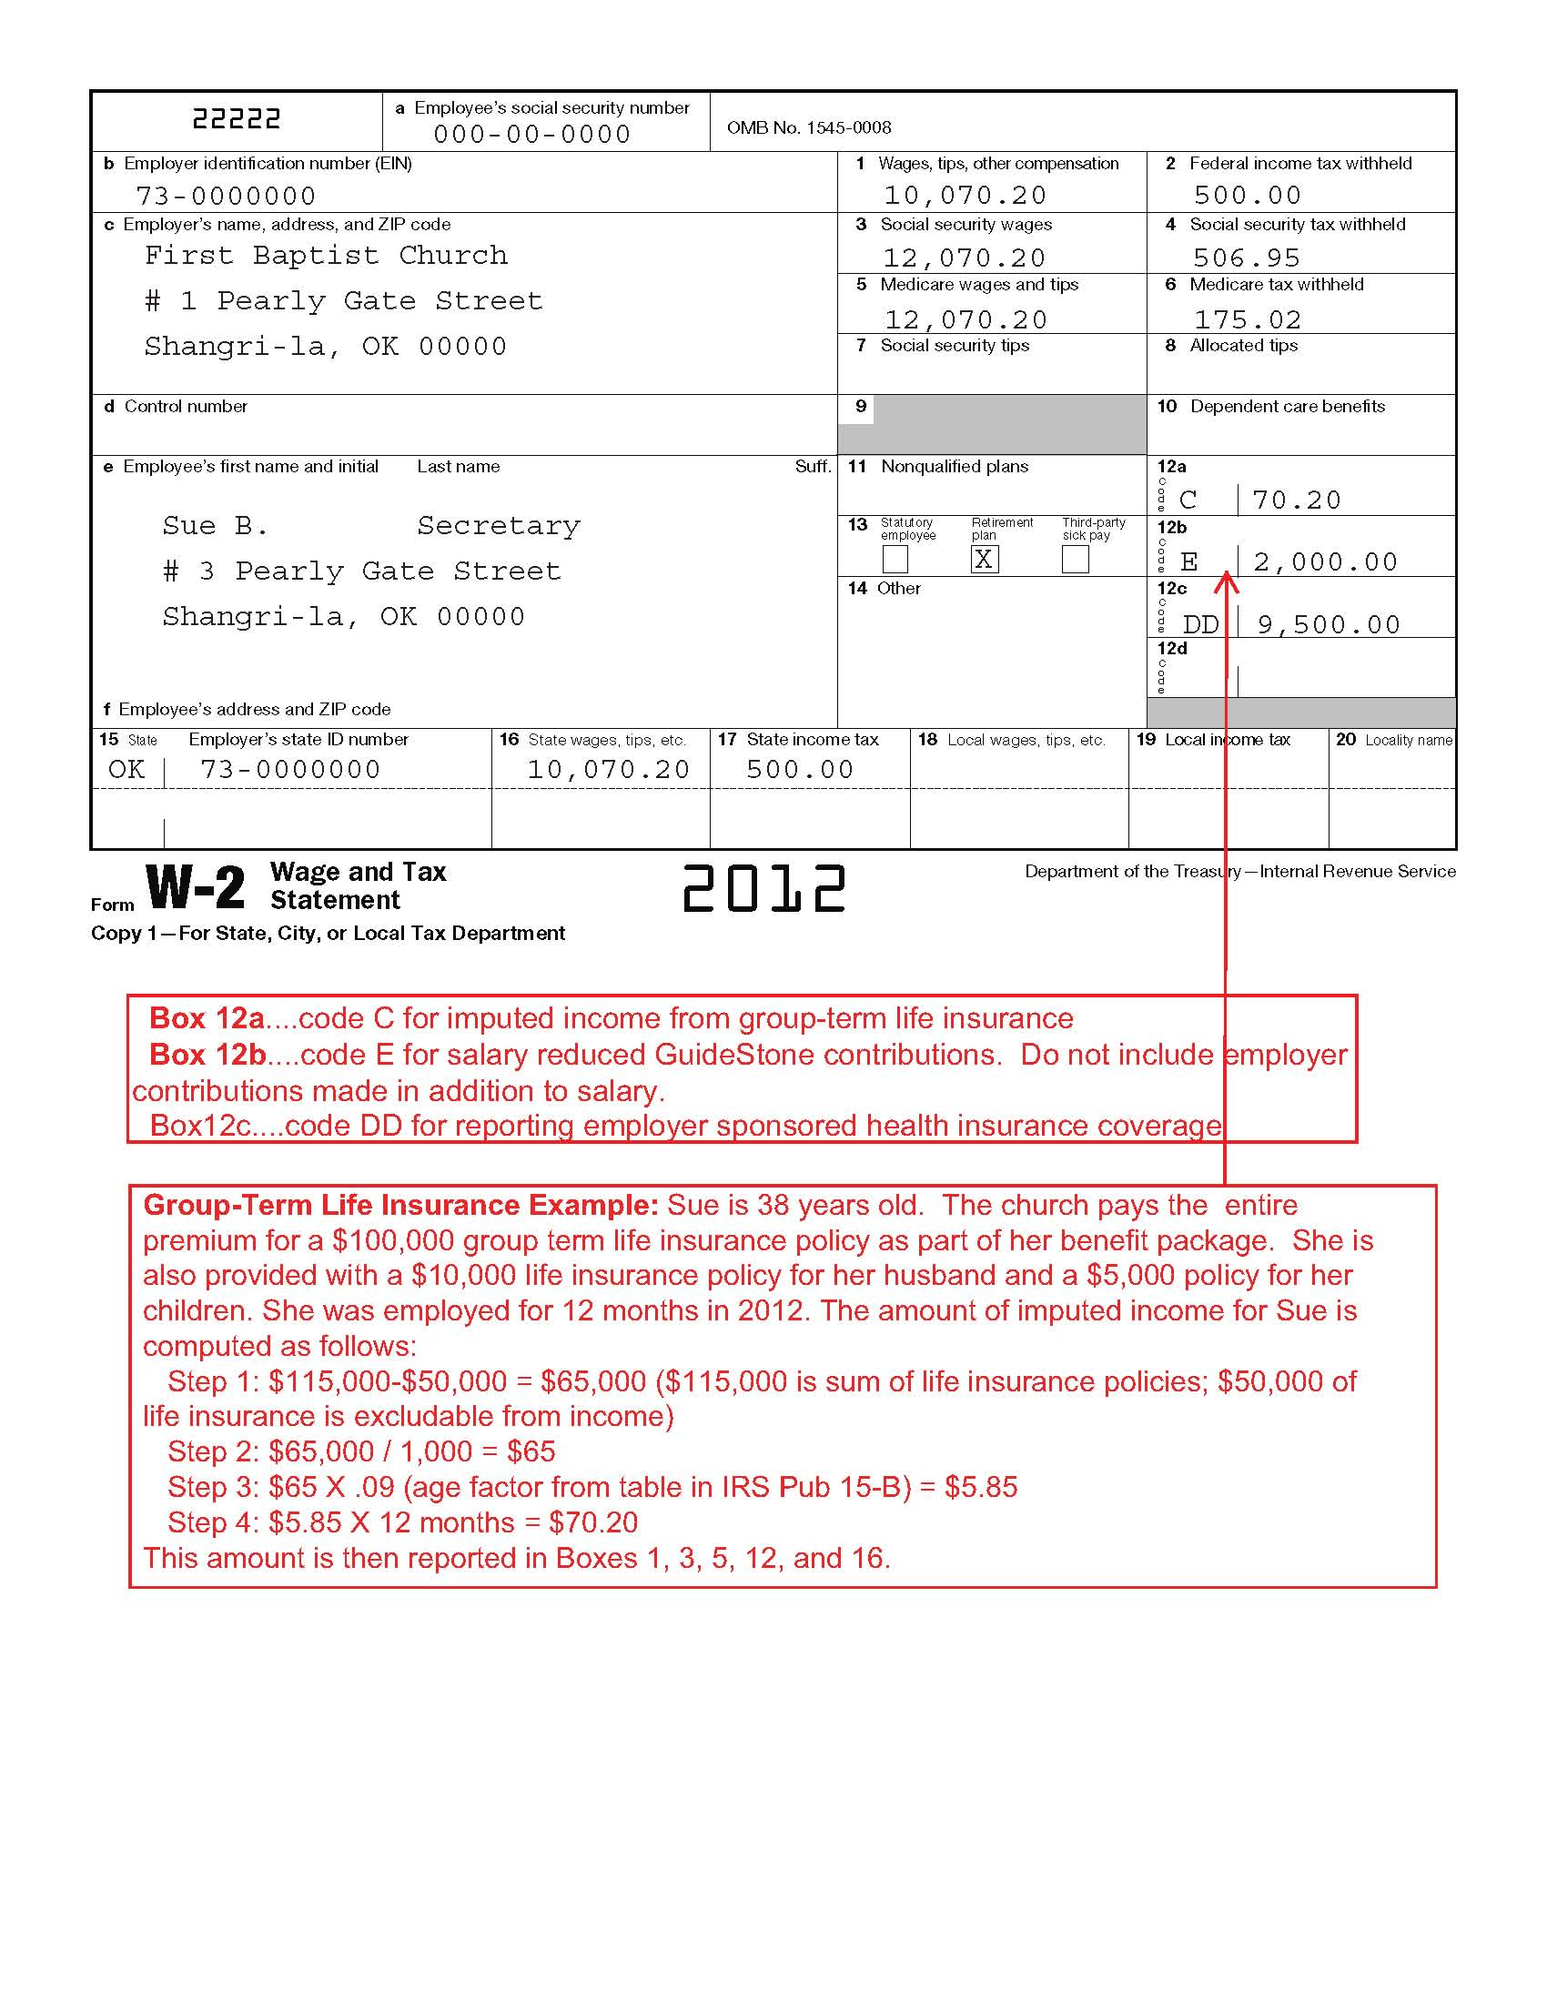
W2, Non-Ordained Employee
Wkbk
Pg 27

Slide 26
Reporting of Health Coverage
Wkbk
Pg 29

Slide 27
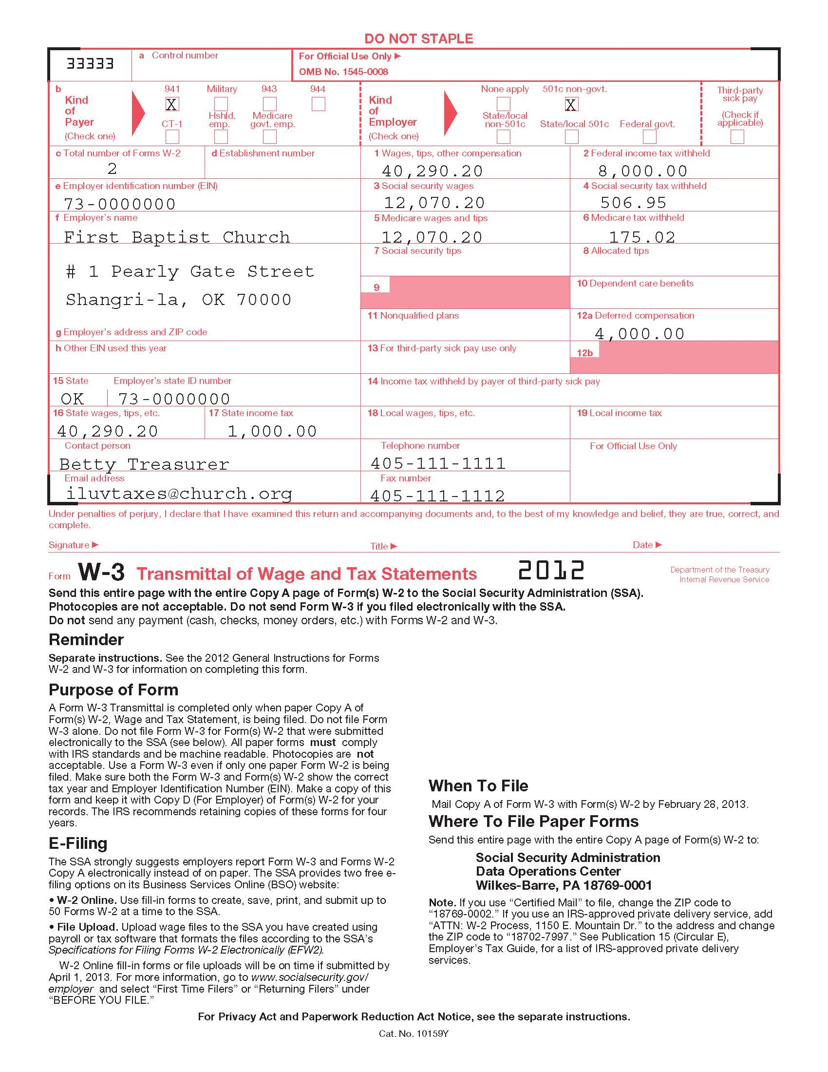
W-3, Transmittal
Wkbk
Pg 31

Slide 28
W2c, Corrected
Wkbk
Pg 32

Slide 29
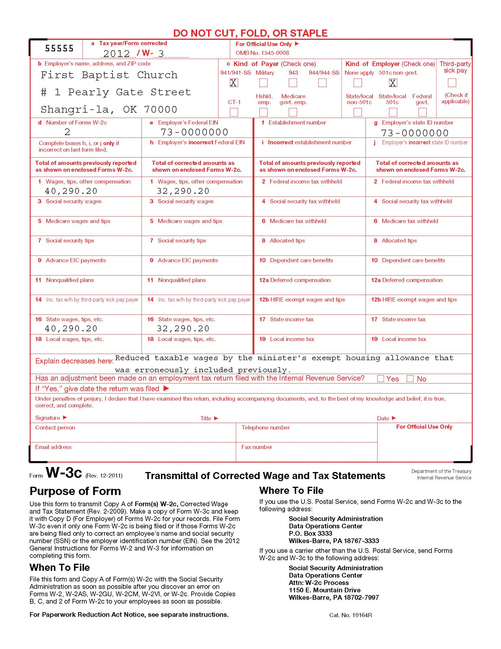
W3c, Transmittal Corrected
Wkbk
Pg 33

Slide 30
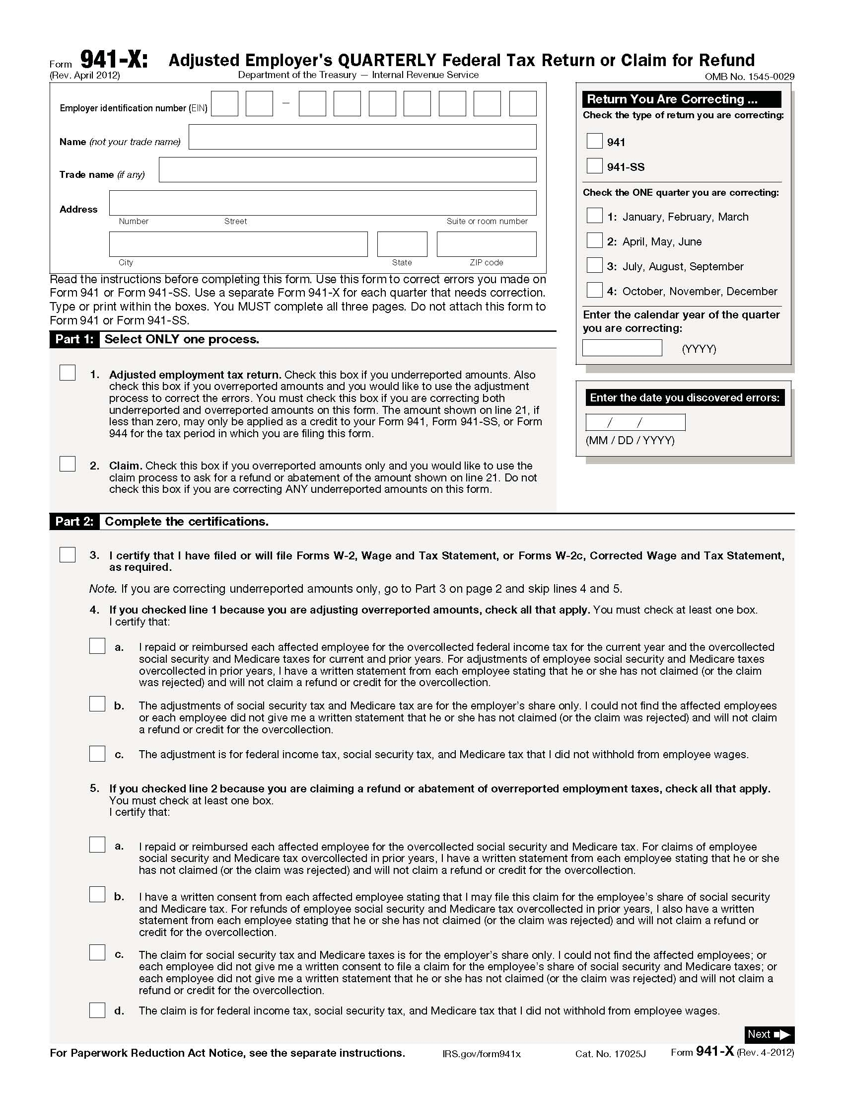
Form 941-X
Wkbk
Pg 34

Slide 31
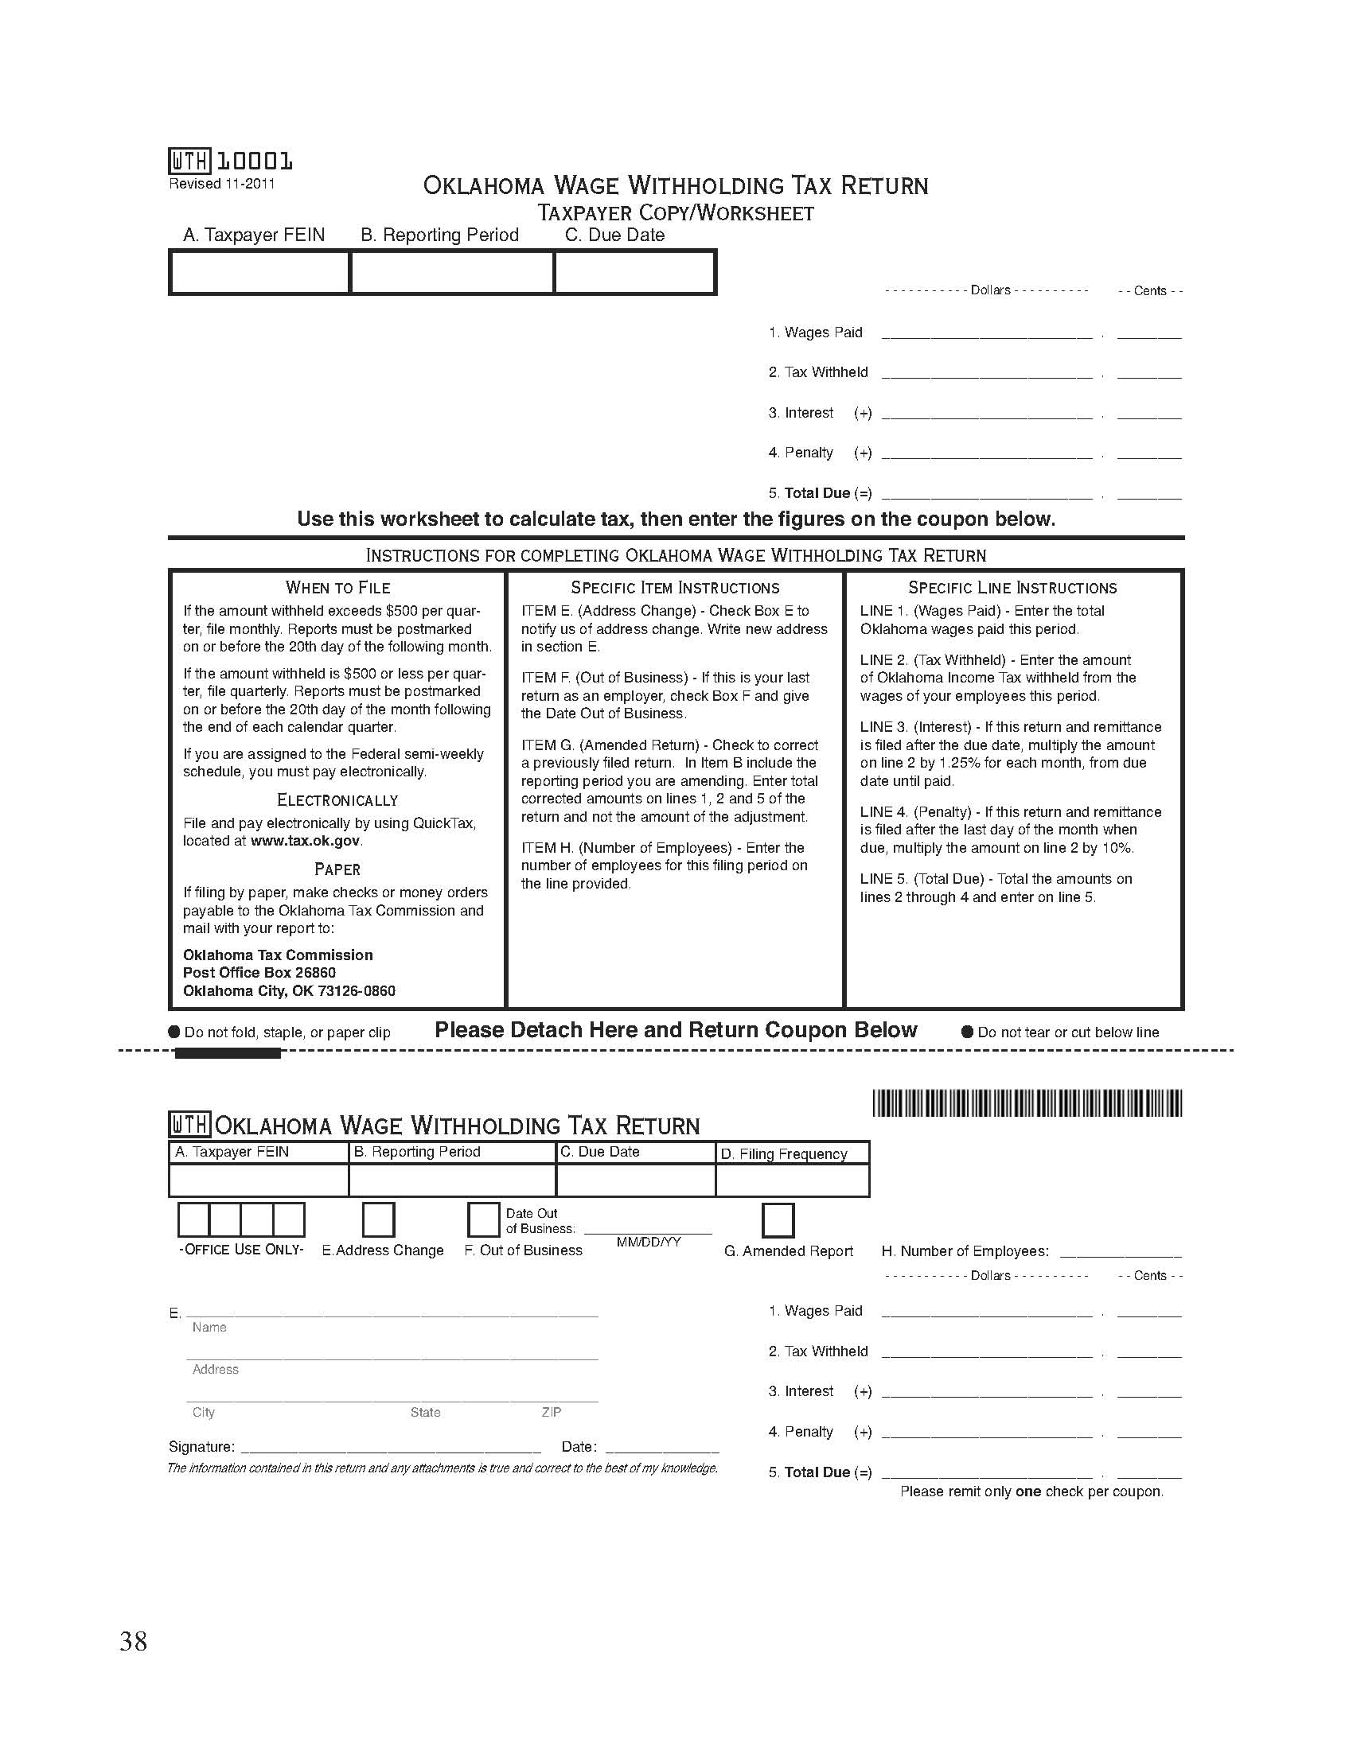
Form OW-9, Oklahoma
Workbook Page 38

Slide 32
Quick Tax Online Filing for Oklahoma
Workbook Page 39
http://www.tak.ok.gov/qtindex.html

Slide 33
Workers’ Compensation Insurance
Workbook Page 40
Required of ALL employers, including churches
Coverage Options
  Private Insurance Carrier
  CompSource Oklahoma
  BGCO Master Plan, Barbara Spess, Administrator
Penalties
  First offence - $250 per employee
  Second offence - $1000 per employee
  Third or later offence – Could close the church

Slide 34
BGCO Workers’ Compensation Rates
Workbook Page 41
Class Code | Class/Description | Est. Payroll | No. of Emp. | Rate per $100 Salary
8840 | Professional, Pastor, Staff, Secretary, Nursery
9101 | Religious Organization - NOC
7308 | Drivers, i.e. Bus Drivers
8868 | School Professionals,
8869 | Day Care Professional
9015 | Camp Operations – NOC

Slide 35
Contractor Notice & Agreement
Workbook Page 43

Slide 36
Employee Checklist
Workbook Page 44
Must be completed by the employer for:
All NEW Employees
New Hire Report
I-9
W-4
ALL Employees
941 or 944
Oklahoma Withholding
W-2 & W-3
Workers’ Compensation

Slide 37
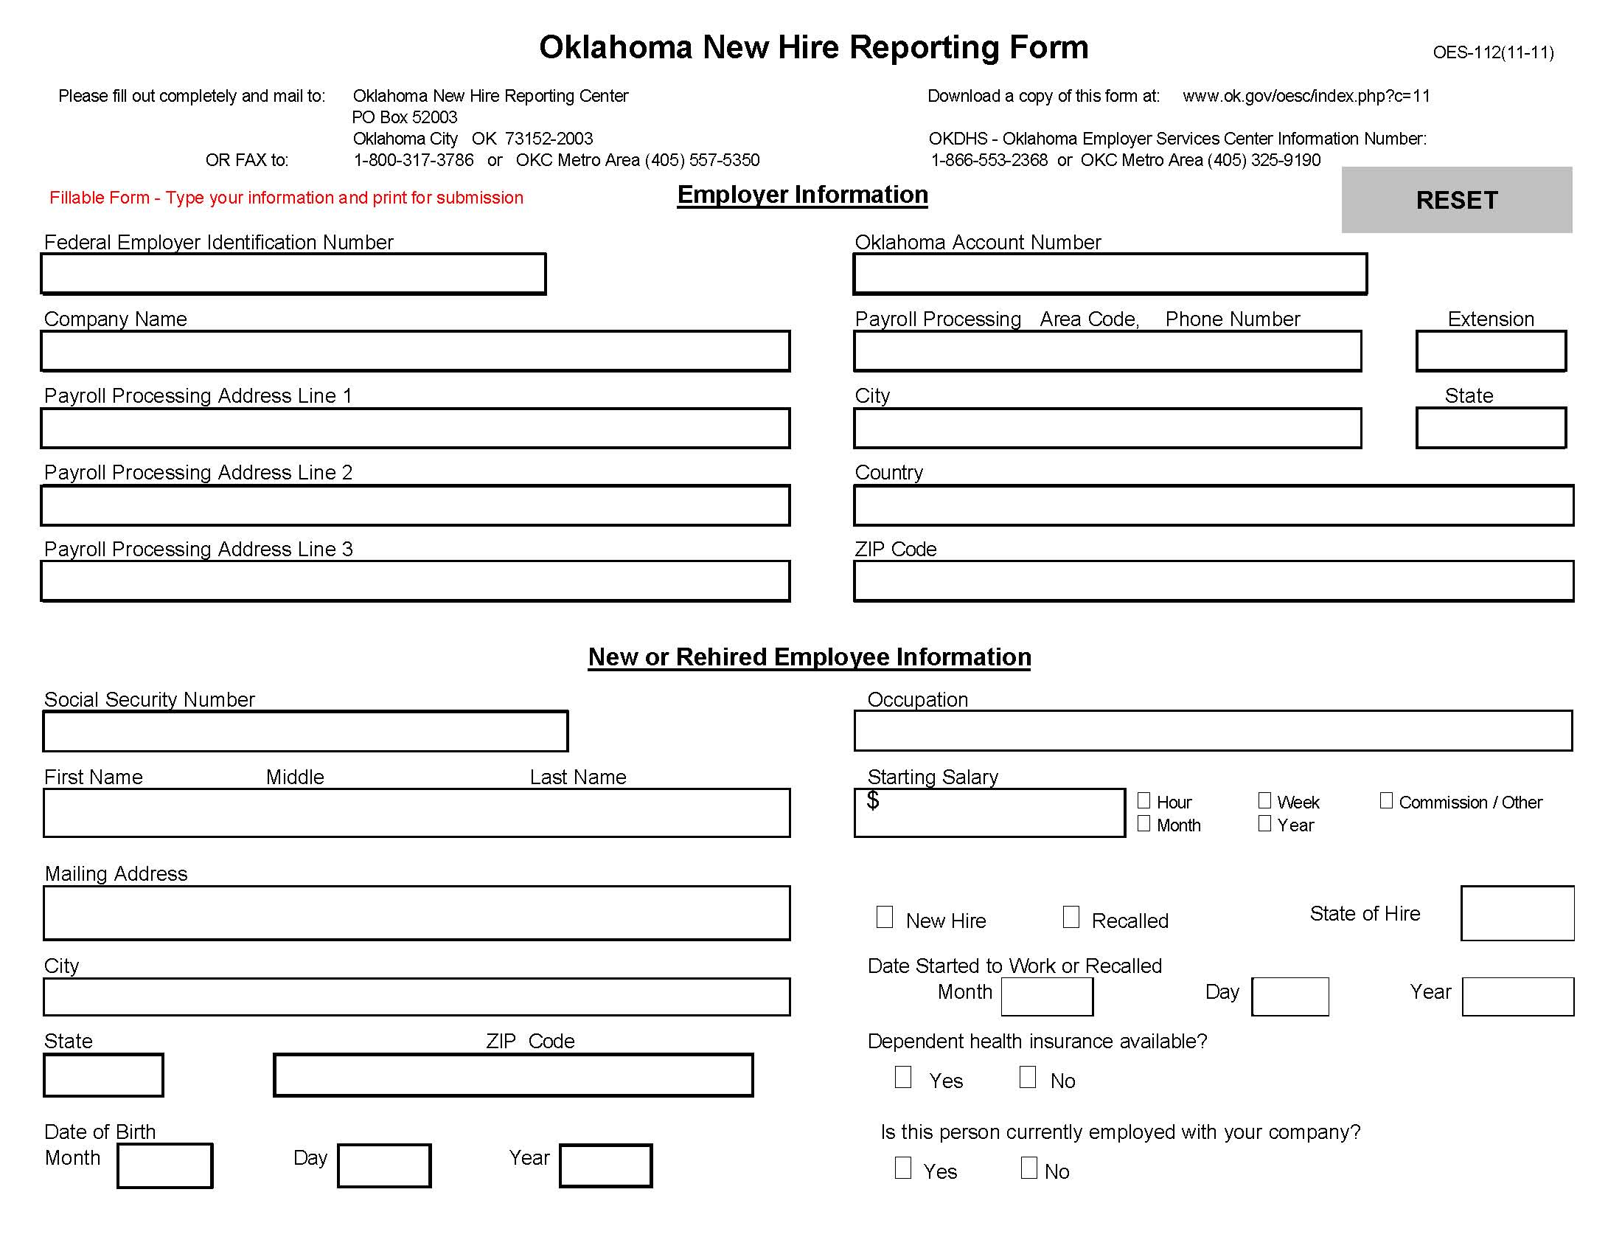
Wkbk
Pg 45

Slide 38
New E-Verify
Workbook Page 46
Department of Homeland Security
Verify new employee eligibility
Easy, free and voluntary
To sign up or learn more,
go to www.uscis/everify.
To register for E-Verify,
go to http://e-verify.uscis.gov/enroll.

Slide 39
I-9 Form
Workbook Page 47

Slide 40
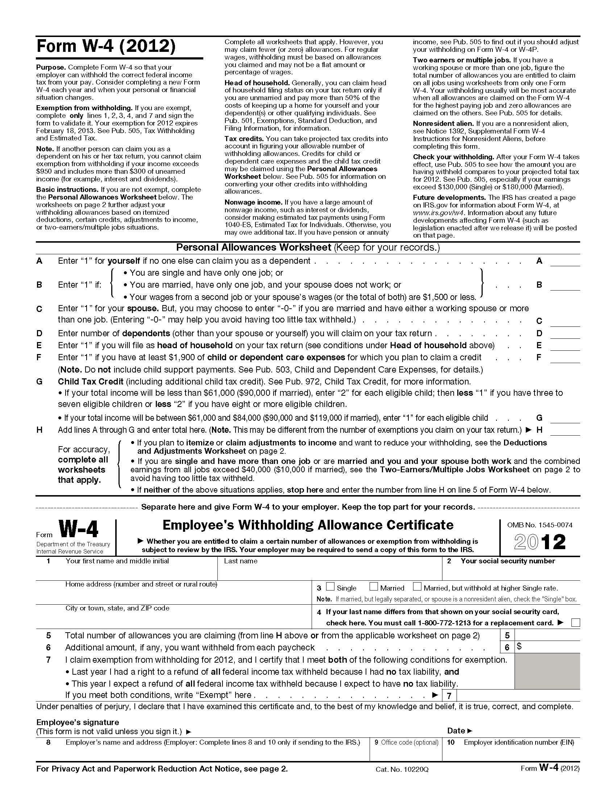
W-4 Form
Wkbk
Page 50

Slide 41
Section II
Workbook Page 52
Independent Contractors and Reporting Requirements

Slide 42
Contract Labor Requirements
Wkbk Pg 52
Form 1099 required if all be following are exist:
  Service provided by a non-employee
  Not a corporation (LLC not a corporation in OK)
  Paid $600 or more during the year
Form W-9 also must be on file
Ask for proof of Workers’ Compensation
  Or unexpired Certificate of Non-coverage.

Slide 43
Independent Contractor Checklist
Workbook Page 53
IRS Form W-9
IRS Form 1099-Misc
IRS Form 1096
OK Form 501
AND
Proof of Workers’ Compensation, OR
Affidavit of Exempt Status, OR
Family of 5 Exemption

Slide 44
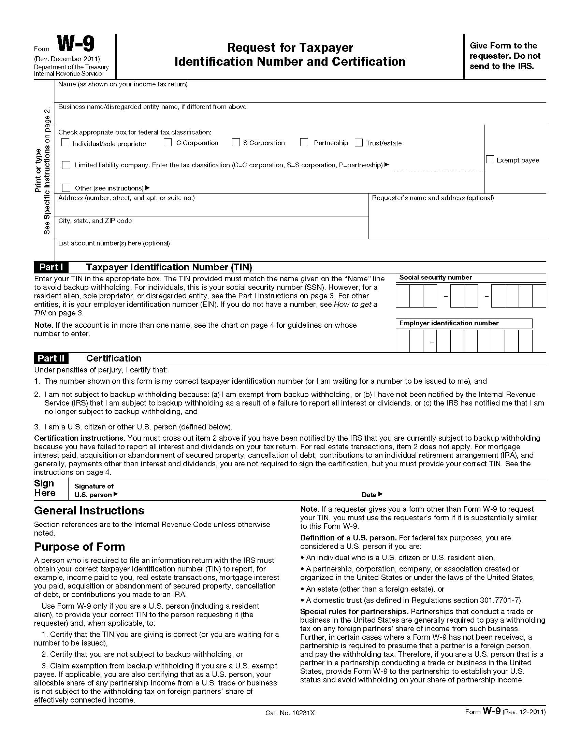
Form W-9
Workbook Page 54

Slide 45
IRS Form 1099-MISC
Workbook Page 56

Slide 46
Form 1096
Wkbk
Pg 57

Slide 47
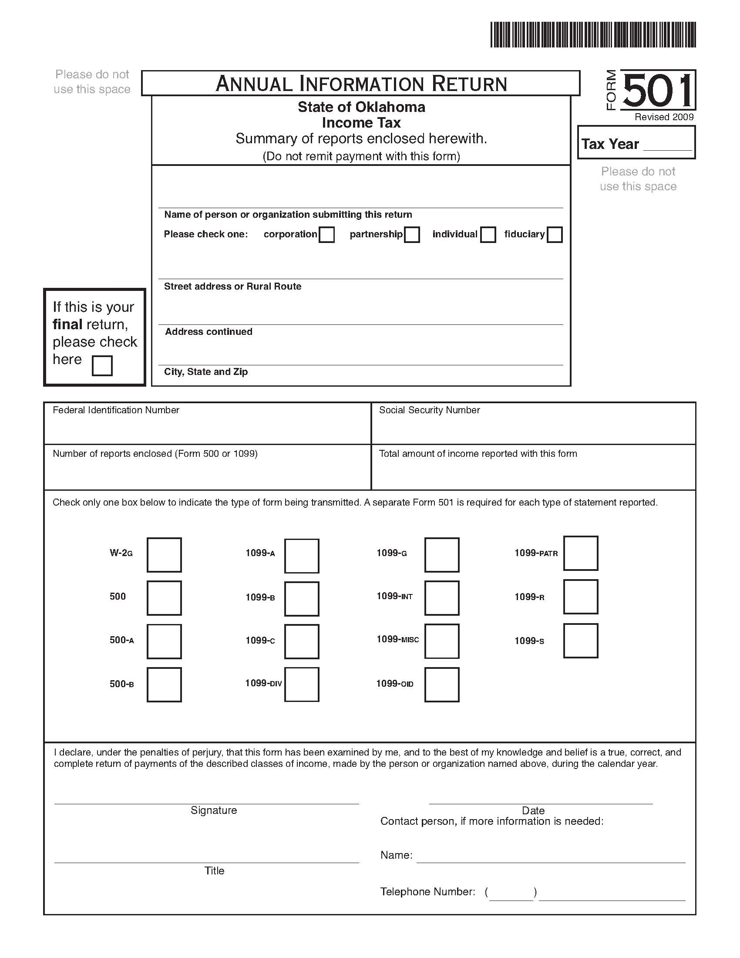
Workbook Page 58

Slide 48
Affidavit of Exemption from WC
Wkbk Pg 60

Slide 49
Independent Contractor Checklist
Wkbk Pg 61
If 6 or more do not apply, then not an Independent Contractor
1. Independent from contractor
2. Little control
3. Distinct occupation
4. Usually done by specialist
5. Requires special skills
6. Tools not supplied
7. Length of job is short
8. Paid as a separate contractor
9. Not regular business of employer
10. You do not consider yourself an employee
11. Cannot terminate without liability

Slide 50
Family of Five Exemption
Workbook Page 62
Five or less total employees, all of whom are related to the employer by blood or marriage.
If you employee someone who claims this exemption:
  A statement specifically claiming this exemption must be on each invoice.
  Each of the working family members should sign each invoice and include their SSN.

Slide 51
Section III
Workbook Page 64
Housing Allowance – Who Gets It and How Much

Slide 52
Minister’s Housing Allowance
Workbook Pages 64
Who Qualifies? – Ministers
What is Included? – Home/Parsonage expenses
How Much can be Designated? –
The least of:
  Actual amount
  Designated amount, cannot be retroactive
  Fair rental value, including furnishing, utilities, etc.

Slide 53
Workbook Page 64
Licensed
Ordained
Secular
Housing Allowance
Pays self-employment tax; church cannot withhold and match.
No Housing Allowance
The church Must withhold Social Security and match; No self-employment tax.

Slide 54
Typical Housing Allowance Expenses
Workbook Pages 65
Rent or mortgage payments on residence
Taxes and interest on home
Insurance on home & contents
Repairs, maintenance, improvements
Furniture, appliances, computer
Decorator Items
Utilities
Miscellaneous

Slide 55
Minister’s Housing Allowance
Wkbk Pgs 65-66
Maximum Housing Allowance –
  Amount actually spent to provide a home
  Amount designated by the church
  The fair rental value of the home plus furnishings, utilities, garage, etc.
Church Parsonage –
  Non-ordained employee
  Ordained employee
Retired Ministers –
  Designated from GuideStone’s retirement plan payments

Slide 56
Maximum Annual Housing Allowance – Example
Workbook Pages 67
Appraisal value of home $100,000
Monthly housing allowance
  Fair market rental value (1%) $1,000/mo
  Furnishings (50% of 1,000) 500
  Utilities (estimate) 400
Monthly Total $1,900/mo
Maximum annual housing allowance $22,800/yr

Slide 57
Section IV
Workbook Page 69
Healthcare Expenses – Reducing Taxable Income

Slide 58
Workbook Page 69
Healthcare Benefit Options
Flexible Spending Accounts (FSA)
Health Savings Accounts (HSA)
Medical Reimbursement Funds (MRF)
Healthcare Reimbursement Arrangements (HRA)
Insure Oklahoma/O-Epic

Slide 59
Healthcare Benefits
Wkbk
Pgs 69-70
Premiums not taxable to employee
  May be paid directly by the church
  May be paid to an independent fund
  May be reimbursed to employee with documentation
New small business tax credit
  For regular health, dental, and vision insurance
  Tax credit of up to 25% of employer paid premiums
  File IRS Forms 990-T & 8941

Slide 60
Section V
Workbook Page 72
The Employee Compensation Package

Slide 61
Church Retirement Plan
Eligible Participants
ChRP
p. 3
Any minister or employee with
taxable income from a recognized
Baptist organization.
Minister or non-minister; ordained or not;
Full-time, Bi-vocational, Part-time, or Interim.
Notes:
Anyone who receives taxable income from a Southern Baptist church, church-related school or association can participate in this plan.
This includes both ministers and non-ministerial employees as well as persons who are considered either full-time, part-time or bivocational.
Anyone who works a heartbeat for a penny.

Slide 62
Plan Advantages
ChRP
p. 2
  Ethical investment philosophy
  Tax savings possibilities
  Housing allowance for retired ministers
  Added protection benefits for qualified participants
Notes:
With thousands of investment options for ministers and church employees, why use the Church Retirement Plan? Here are five valuable considerations:
You can reduce your taxes in several ways with this plan. Income taxes are deferred on both contributions and earnings. Contributions by ordained ministers are also deferred from Social Security taxes — this is not the case with an IRA. And if you are serious about lowering your taxes as much as possible, the tax-sheltered contribution limits are also higher in a 403(b) plan than with an IRA. In fact, in a 403(b) plan you may be able to tax shelter up to 100% of your taxable income under certain conditions!
The Church Retirement Plan doesn’t just help you prepare for tomorrow, it also includes valuable features that protect you today. These include disability and life protection benefits and matching retirement contributions that are provided at no additional cost by your Baptist state convention to eligible plan participants. These features will be discussed in detail in a moment.
When you invest through the Church Retirement Plan, you can feel good about how your money is invested. The investment philosophy of GuideStone Funds means your retirement account will not be invested in any company that is publicly recognized as being in the liquor, tobacco, gambling, pornography or abortion industries.
And last but not least, if you are an ordained minister who participates in the Church Retirement Plan, the law allows GuideStone as a church pension fund to designate your retirement benefit as a housing allowance within legal limits. With this designation, a minister pays no income tax on the retirement distribution if it is used to provide their home. This additional tax savings can be significant. For example: a minister in a 15% income tax bracket receiving a $1,000 monthly benefit designated as housing would save $1,800 in taxes every year.
Pay every penny I owe, but not one penny more.

Slide 63
Disability Income Benefit
  $500 per month disability benefit
  $35 per month retirement contributions
ChRP
p. 3
Notes:
The Disability Income Benefit provides up to $500 a month in disability income to an eligible Church Retirement Plan participant who becomes disabled. This benefit is paid in addition to any disability insurance or Social Security-provided benefits.
Plus, every month this disability benefit is paid, a $35 contribution is also made into the retirement account of the disabled Church Retirement Plan participant.
Just like the previously described Survivor Protection benefit, this disability benefit also has no medical underwriting, and is provided at no additional cost to a participant or their church.

Slide 64
Survivor Protection Benefit
ChRP
p. 3
  Benefit amount depends upon a participant’s age at death
  Paid in addition to all the money in your retirement account
Your age at death | Maximum benefit payable
35 and under | $100,000
36–45 | $75,000
46–55 | $50,000
56–65 | $25,000
66–70 | $16,000
71 and over | $10,000
Eligible participants earn 1/12 of the value of these benefits for each consecutive month of participation in the Church Retirement Plan for each of the 12 months immediately preceding your death or disability.
Notes:
The Survivor Protection Benefit is designed to be similar to life insurance. Survivors of an eligible Church Retirement Plan participant who dies while active in the plan receive this benefit. The chart on the right shows how the exact benefit amount is determined by the age of the participant when death occurs, but it can be as much as $100,000.
This benefit is paid to survivors in addition to all the money in a participant’s Church Retirement Plan account.

Slide 65

Matching Retirement Contribution
ChRP
p. 4
State Convention Contributions
$105.00
  For those in a ministry position
  Up to $210/year
  $1 for $3 match
  MCAF included in monthly contributions
Matching Retirement
Contributions
$1 for every $3 contributed
Maximum $17.50
Your Monthly Contribution Level
$52.50
Protection Benefits
Disability Income Benefit
Survivor Benefit
$1.00
Notes:
The final state convention provided feature for eligible participants in the Church Retirement Plan is a matching retirement contribution. It can equal as much as $210 per year.
The bottom of the chart on the right, shows that monthly Church Retirement Plan contributions from $1 up to $52.50 per month qualify for the previously described disability and survivor benefits.
The top of this chart indicates that eligible participants will also receive a $1 convention match for every $3 they have in monthly contributions between $52.50 and $105. Both employer, participant and MCAF contributions count toward this matching arrangement.
While a monthly contribution of $105 will qualify for the maximum $17.50 matching convention contribution, 10% employer and 5% participant contribution goals are still strongly recommended.

Slide 66

Mission/Church
Assistance Fund
Annual church budget
under $75,000
Up to $3,000 additional
retirement contributions.
Notes:
If you are a pastor and you serve a church or mission that has a total annual budget of less than $75,000, you may also be eligible to receive up to $3,000 in additional retirement contributions through GuideStone’s Mission/Church Assistance Fund. Ask one of our customer service representatives about this added financial help available for small churches and missions.

Slide 67
Annuity Funding Rate Change
Annuitizing is one option
The monthly annuity benefit is based on:
  Amount annuitized
  Ages of annuitants
  Funding rate - currently at 6.00%
The funding rate is changing
  The change begins January 1, 2011
  The funding rate will be reduced to 3.75% by July 2011
  For every 1% change in the funding rate changes monthly annuity benefits by about 10%.
  For those annuitizing in 2010 the funding rate will still be 6.00%

Slide 68
403(b) Regulation Change Requirements
Workbook Page 73-74
  Written plan document
    Available at www.guidestone.org
    403(b)(9) Retirement Plan for Southern Baptist Churches
    Contribution & Eligibility Schedule
  Information Sharing Agreement
    Only if the church uses more than one retirement plan company
  Administrative responsibilities
    Follow the plan
    Make contributions within a reasonable time (15 days)
    Sign off on plan distributions, loans, etc.
Notes:
These new 403(b) regulations have three major implications.
First, every Church that offers the Church Retirement Plan will need to have a written plan document. This written document will need to describe such things as who is eligible to participate in the plan, the types and amounts of contributions that will be allowed by the plan and the details about how the plan will work.
Secondly, if your church sends retirement contributions to more than one retirement plan vendor, or allows your retirement plan participants to transfer funds from one retirement plan vendor to another, you will need to enter into an information sharing agreement with each retirement plan vendor you use.
And third, with these new regulations your church will have some new administrative responsibilities such as signing off on plan transactions such as loans, distributions and to transfer funds between retirement plan vendors (known as “contract exchanges”).

Slide 69
Wkbk Pg 75

Slide 70
Compensation Package
Workbook Pages 72
Total Pay Package $54,700
  Less
  FSA Medical 2,500
  FSA Childcare 2,000
  Medical and dental insurance 13,700
  Qualified 403(b) retirement plan 5,500
  Housing Allowance (ordained) 31,000
  Total Deductions (54,700)
Taxable W-2 reportable salary $ 0

Slide 71
Retirement Saver’s Credit Rate on First $2,000 of Elective Retirement Contributions
Workbook Page 73
AGI for 2012 joint returns* Credit Rate
0-$34,500 50%
$34,501-37,500 20%
$37,501-57,500 10%
Over $57,500 -0-
* Housing allowance and retirement contributions are NOT included in the AGI.

Slide 72
The “Actual Cost” of a $2,000 Retirement Plan Contribution for a Minister with an MFJ AGI of $34,500 or less
Workbook Page 73
Retirement Plan Contribution $2,000
Possible Tax Benefits
  Savers Tax Credit (50%) $1,000
  Fed Income Tax Reduction (11.15%) 223
  SE Tax Reduction (13.3%) 266
  OK Tax Reduction (5.3%) 106 $1,595
After tax “actual cost” of contribution $405

Slide 73
Salary Reduced Retirement Contribution Limits (2012)
Workbook Page 74
Cannot exceed salary minus housing allowance
General limit is $17,000
Age 50 or over catch up limit is $5,500
15 Year Rule
  15 or more years in ministry
  Up to an additional $3,000

Slide 74
Financial Support Worksheet
Workbook Page 75
Ministry Related Expenses (not salary)
Employee Benefits (not salary)
Personal Income (salary)

Slide 75
Wkbk
Pg 75

Slide 76
Section VI
Workbook Page 76
Employee Business Expenses

Slide 77
Unreimbursed Business/ Professional Expenses
Workbook Page 76
Must use Schedule A for unreimbursed professional expenses.
Only 50% of unreimbursed business related meals & entertainment expenses are deductible.
Only unreimbursed professional expenses above 2% of AGI are deductible.
Unreimbursed professional expenses are limited to the percent of taxable salary.

Slide 78
Employee Business Expenses
Wkbk Pgs 76-78
Dalan Ruling
Accountable Plans – Not taxable
  Business connection
  Substantiation
  Return of excess amounts
  Not through salary reduction
Non-accountable Plans – Taxable
  Reported as salary on W-2
  50% limitation on meals & entertainment

Slide 79
Employee Business Expenses
Workbook Pgs 78-79
IRS revokes ruling on salary reduction
Reimbursed travel expense of spouse
Cell Phones

Slide 80
6 Dangers of Church Credit Cards
Workbook Page 74
Receipts not given to church
Personal charges made on card
Used for the convenience of employees or members
No credit card policies
Used to bypass church purchase orders
Credit card not handled securely

Slide 81
Sample Reimbursement Policy
Workbook Page 79
Reimburse only ministry related expenses, subject to budget limitations.
Each expense must be documented, usually with a receipt.
Advances, reimbursements, and refunds must be handled within a reasonable time.
Reimbursed amounts are not taxable income.

Slide 82
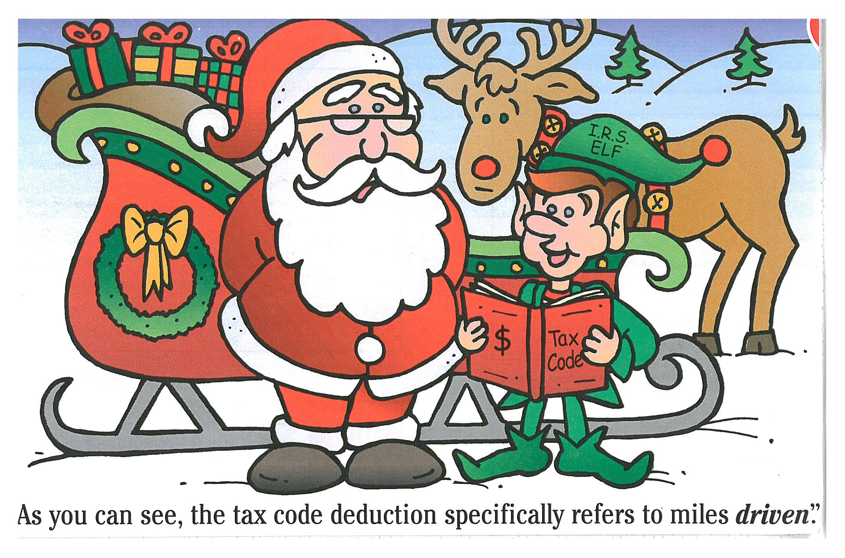

Slide 83
How to Prove
Certain Business Expenses
Workbook Page 80

Slide 84
Reporting Travel, etc.
Workbook Page 81

Slide 85
Commuting & Business Mileage
Wkbk
Page 81
Always
Deductible
Always
Deductible
Always
Deductible
Prospective
Member
Never Deductible
Church
Home
Deductible
(unless a
regular stop)
Always
Deductible
Local Hospital

Slide 86
Wkbk
Pg 83

Slide 87
Section VII
Workbook Page 84
Charitable Contributions

Slide 88
Contributions
Workbook Page 84
All cash gifts – receipt required
  > $250 – for intangible benefits only
Non-monetary – clothing/HHGs
  Must be in good or better condition
  Stated on receipt

Slide 89
Vehicle Donations > $500
Workbook Pages 84-85
Sold = gross proceeds
Use or improvement = FMV
Form 1098-C
Penalties for false statement

Slide 90
Wkbk
Pg 86

Slide 91
Form 8283

Slide 92
Wkbk
Pg 89

Slide 93
Other Contributions
Workbook Pages 91-92
Donated Services – never deductible
Quid Pro Quo –excess of goods/services supplied
Out of Pocket Expenses – acknowledgement letter
Mission Trips – acknowledgement letter
Year-end contributions – year delivered or postmarked

Slide 94
Designated Fund Giving
Workbook Pages 91-95
Need a Church Policy
Policy Example
  No designated gifts accepted without prior approval
  Designated funds approved by [Finance Committee]
  “Should this be the work of this church?”
  New designated funds announced to entire church
  Administer appropriately
  Funds may be established so they may be used other than as designated
  Release of modification of restrictions on designated funds

Slide 95
Calculating Cooperative Program (CP) & Associational Missions (AM) Giving
Example: 10% to CP & 5% to AM
Workbook Page 91
Step | Calculation | Annual Amount
1 | Total budget before CP & AM | $100,000
2 | Total percent to CP & AM | 15%
3 | Budget % for all other ministries | 85%
4 | Total budget including CP & AM | $117,647
5 | Amount budgeted for CP (10%) | 11,765
6 | Amount budgeted for AM (5%) | 5,882
7 | Recheck total budget amount | $117,647

Slide 96
Section VIII
Workbook Page 96
Church Administration

Slide 97
Document Destruction
Wkbk
Pg 92

Slide 98
IRS 501(c)(3) Tax Exemption
Workbook Page 97
Request in writing on church letterhead from:
Financial Office
Executive Committee
Southern Baptist Convention
901 Commerce Street
Nashville, TN 37203
Phone: 615-244-2355
Fax: 615-742-8919

Slide 99
Application for
Oklahoma Sales Tax Exemption
Wkbk
Pg 99

Slide 100
Wkbk
Pg 102

Slide 101
Church Software http://capterra.com/church-management-software www.ccmag.com
Workbook Page 104
ACS
Ardent
By the Book
CDM Plus
Computer Helper
Daymark
DataWiz
Free accounting tools: www.freechurchaccounting.com
Diakonia
Findex
ICON
Quickbooks
RDS
Shelby
Fellowship

Slide 102
Basic Tax Seminar
2012
Baptist General Convention of Oklahoma
Office of Information Services
Barbara Spess
Norma Woodard
Thomas Jordan

